Slide 1
Youtube Analytics
By Gavin Lampton and Brian Cho

Slide 2
Sections
01
03
02
Collection
Views by Channel
EDA
04
05
Views by Year
Conclustion

Slide 3
Part 1: Collecting Data

Slide 4
Brainstorming
and
Early Collection
Before the project was assigned, I had the idea of looking into Youtube analytics.
I had the idea that I could do my own data collection; it was a bad idea.
The first attempt was manual. It took about 3 hours to collect information from around 150 videos.
I looked into automated methods:
Youtube API is only accessible to Google Cloud servers and therefore costs money.
It turns out you can scroll to the bottom of the videos pane and download videos as an html file.
From there you can use a script to parse the information out of the html file.

Slide 5
Automated
Collection
Bash can collect and format data for a CSV.
Just don’t do anything fancy.
The first problem was that upload time was still string data so R couldn’t sort it.
A second Bash script that fixed that problem only completed about 4/~100 files after 2 hours runtime.
The Python rewrite ran in about 5-10m but all of these scripts both took time to write/debug.
We planned on collecting data from all top 100 channels but had to settle for the ones with upload counts of 9k or less.

Slide 6
Part 2: Exploratory Data Analysis

Slide 7
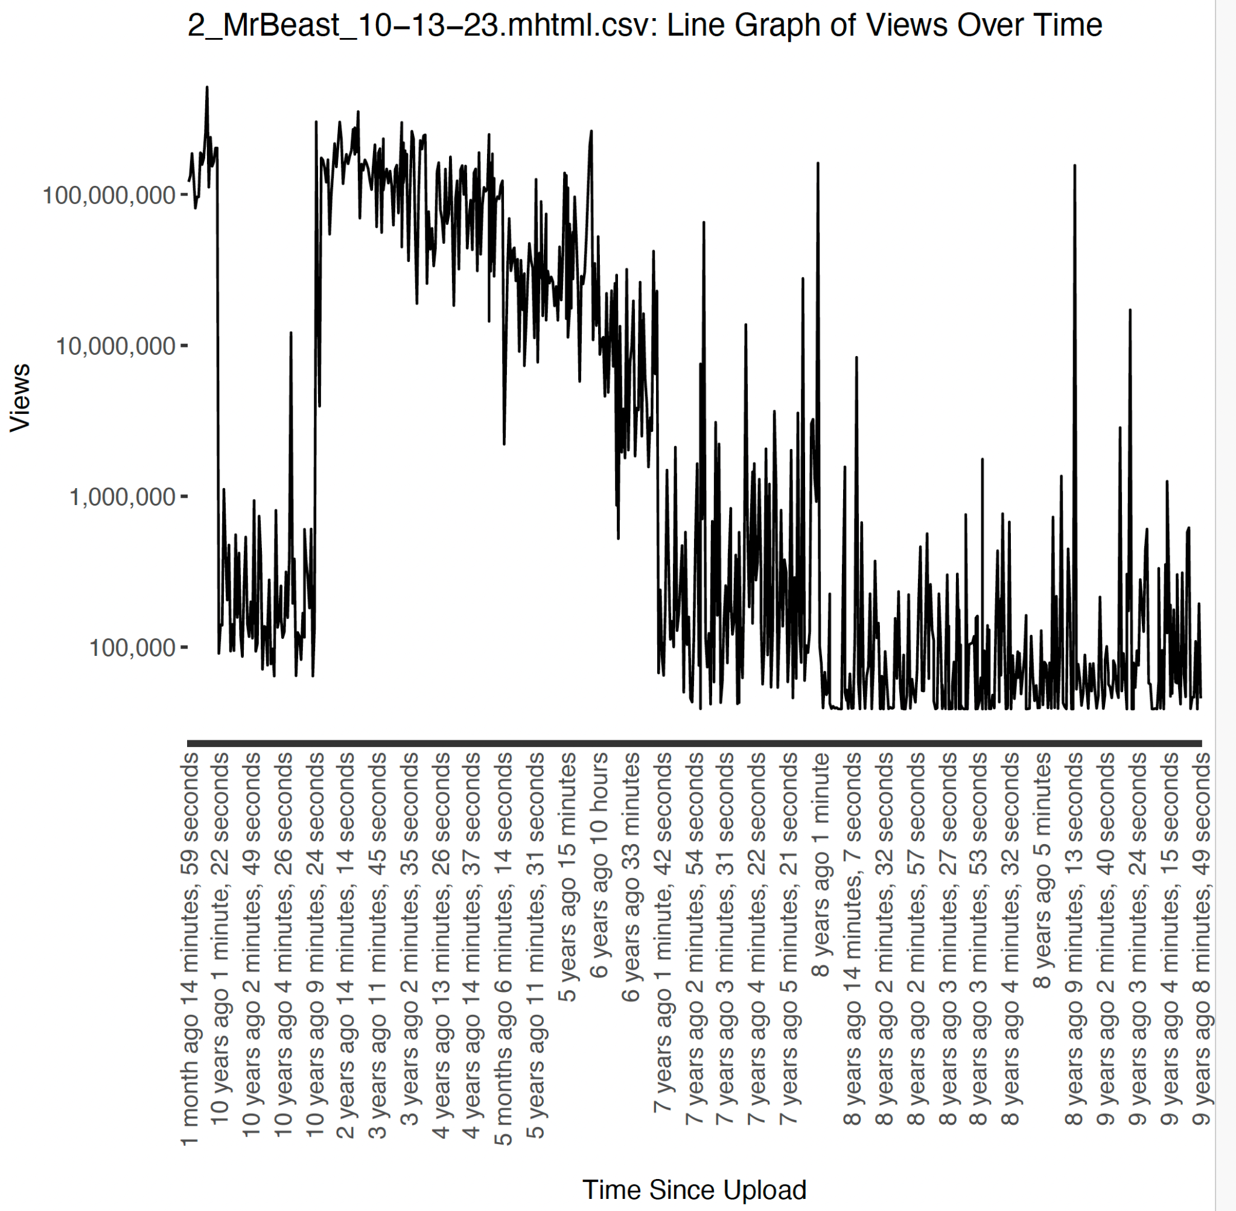
Round 1
The first round of EDA happened after the first automated script collected data but before the second script summed up the upload time.
We ran into the issue of things appearing the in wrong order. This would happen because “8 months …” and “8 years” would be sorted next to each other.
As you can see the 10/11 years ago data was sorted almost next to the earliest information on the graph.

Slide 8
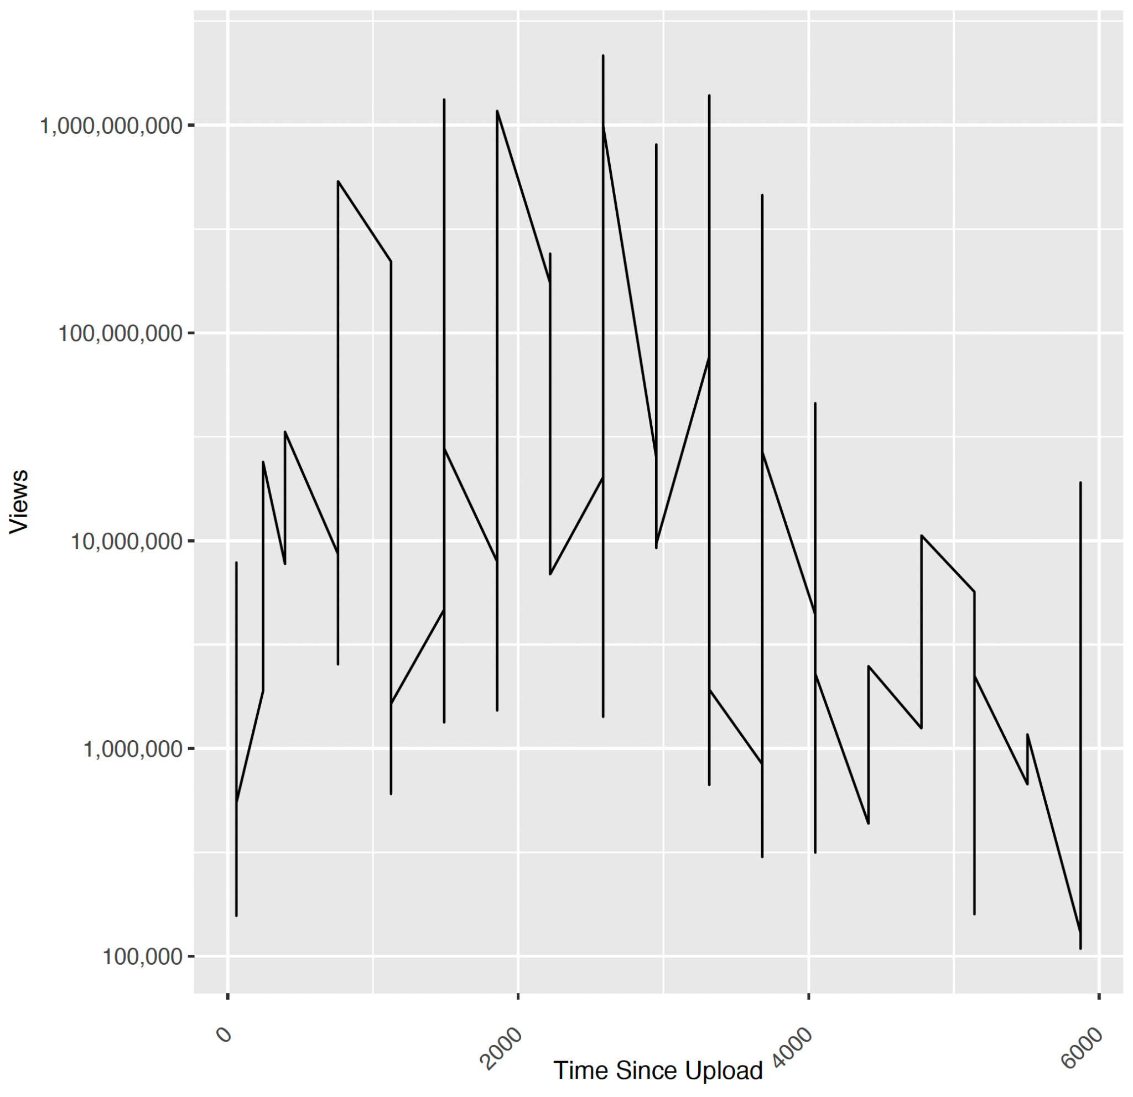
Round 2
After breaking the string data up into integers we ran into a problem where our line graph would clump data points together on the same day.
This is because the data itself would often only include the largest unit along with minutes and seconds.
We ended up throwing out the days since upload column because the collected data couldn’t support it.

Slide 9
With the initial issues out of the way we started working towards our main question:
Who gets the most views on Youtube?

Slide 10
Part 3:
Are the most Subscribed Channels the
Most Viewed Channels?

Slide 11
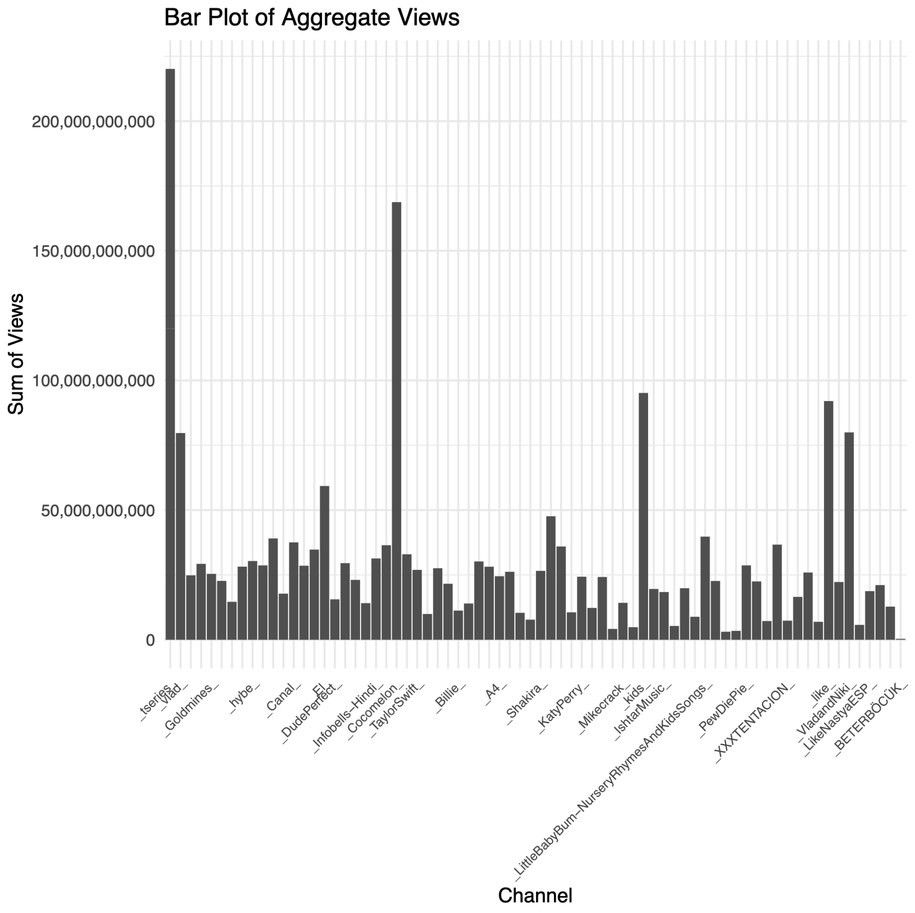
Total Views
We took the sum of total views for each channel and made a bar plot
The plot is ordered from most to least subscribers
There was an error when creating the plot and some of the outliers on the right side of the plot should be closer to the left
Most channels have under 50 billion total views, but there are a handful of outliers
T-Series, Vlad and Niki, El Reino Infantil, Cocomelon, Like Nastya, Kids Diana Show

Slide 12
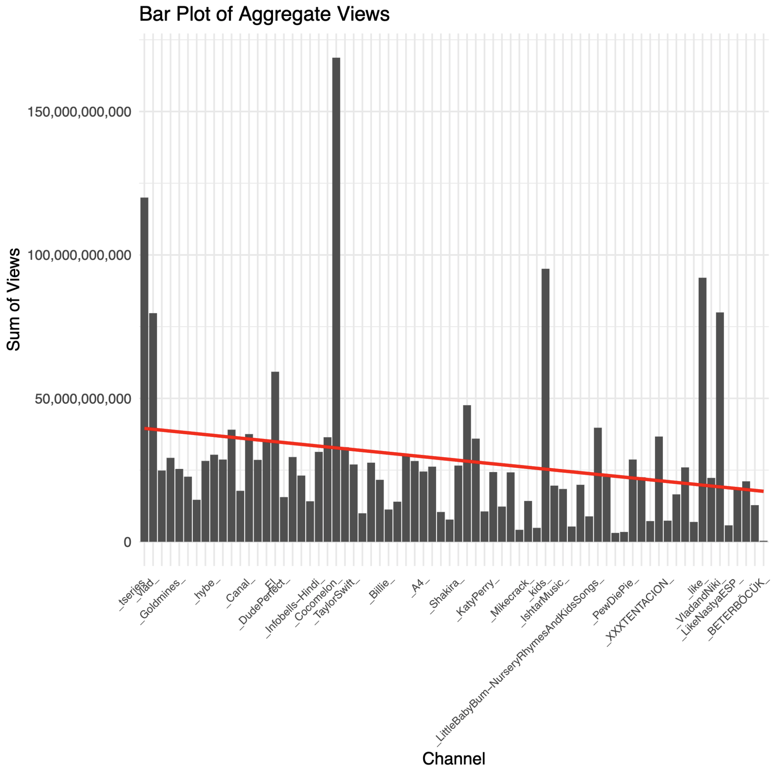
Average vs Total Views
The red line shows the linear model
Due to the outliers, the line likely has a gentler slope, but still shows a downward trend

Slide 13
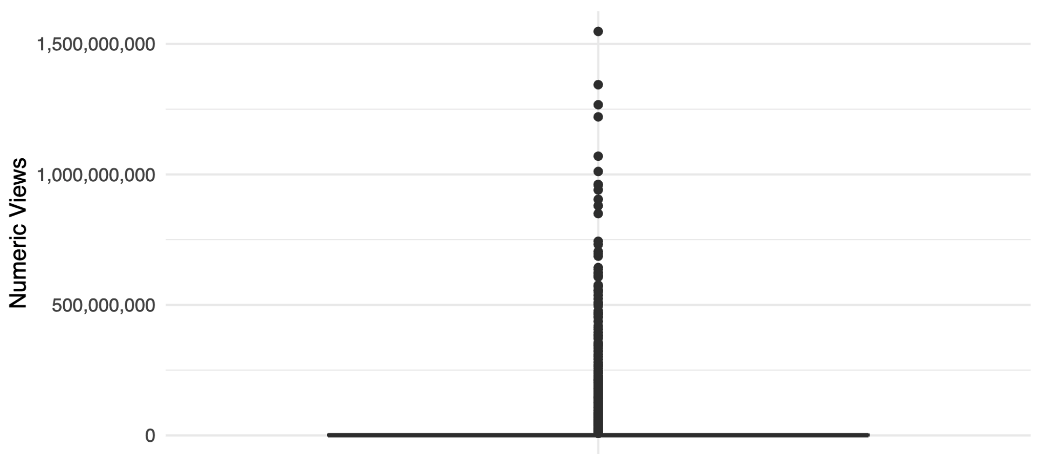
Comparing Values:
Initial Attempt
We wanted to compare different values such as the min, max, and average of different channels so we created box plots

Slide 14
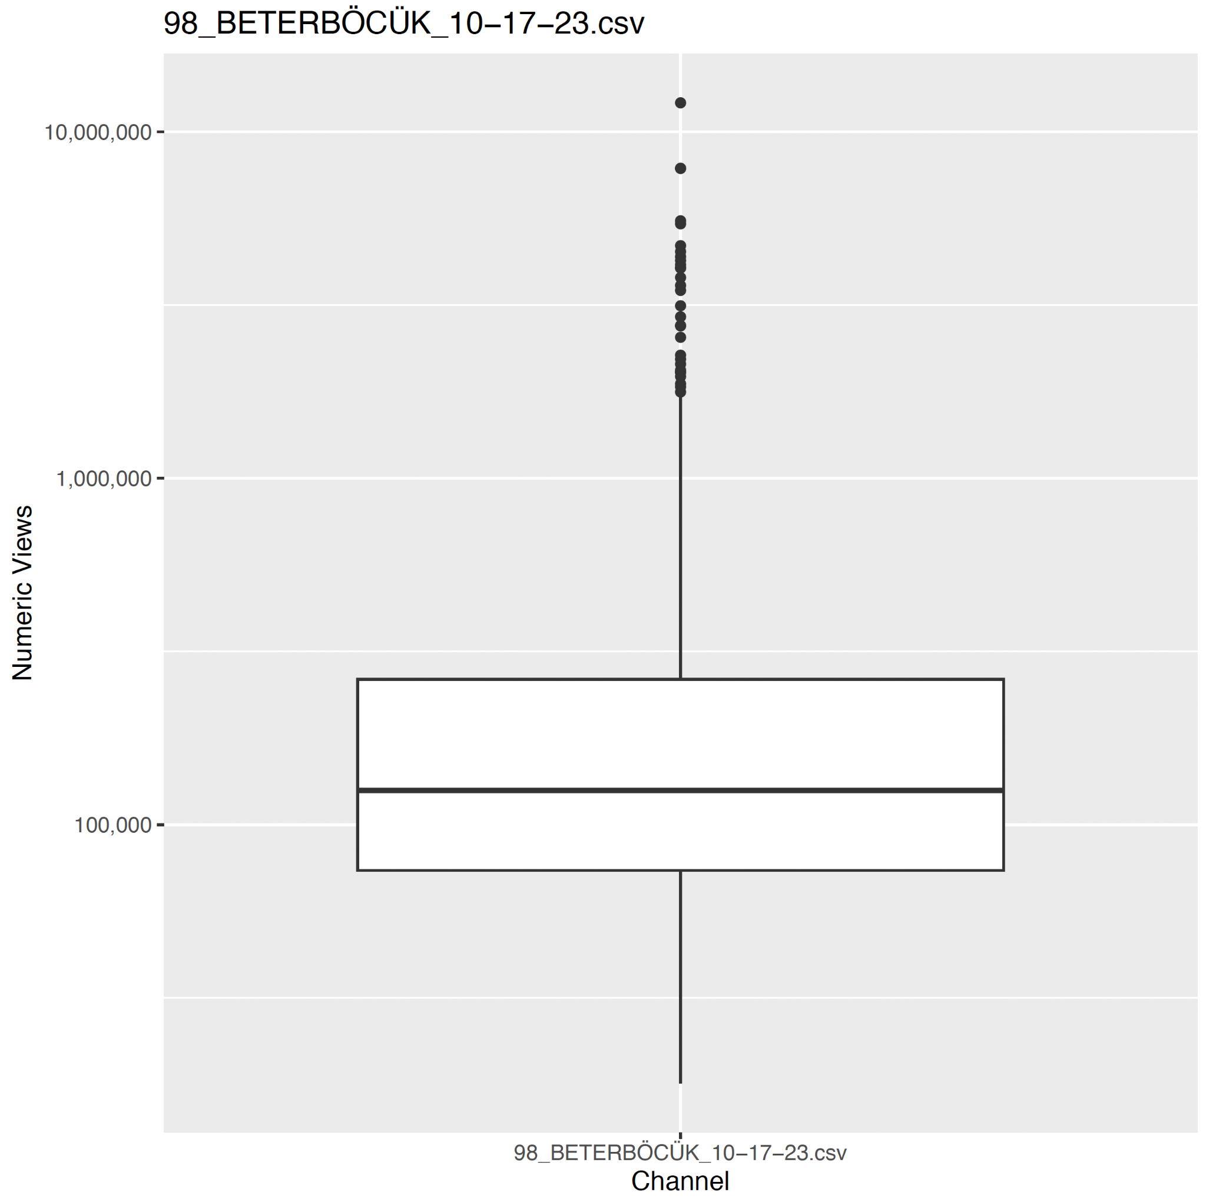
Comparing Values
Once scaled, we can get a better grasp of the data

Slide 15
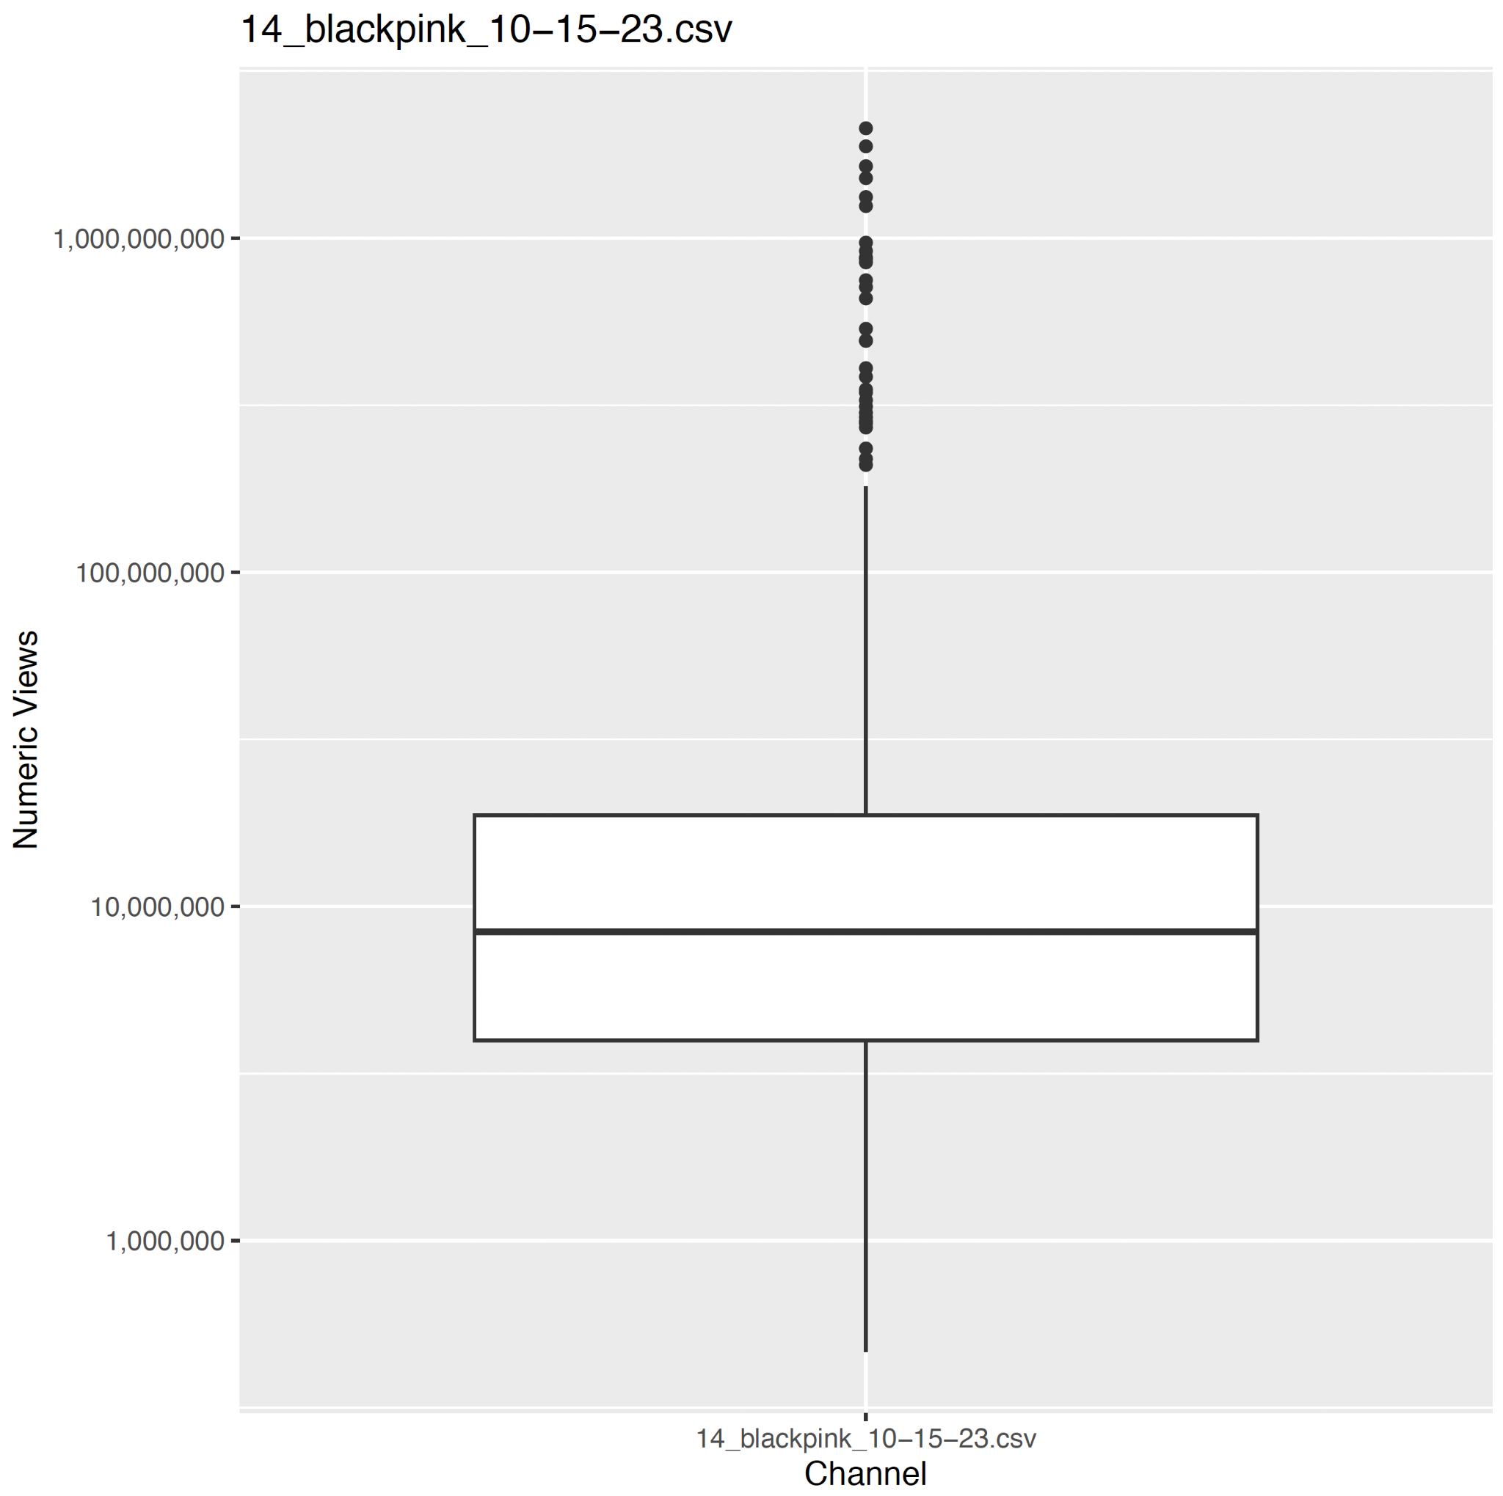
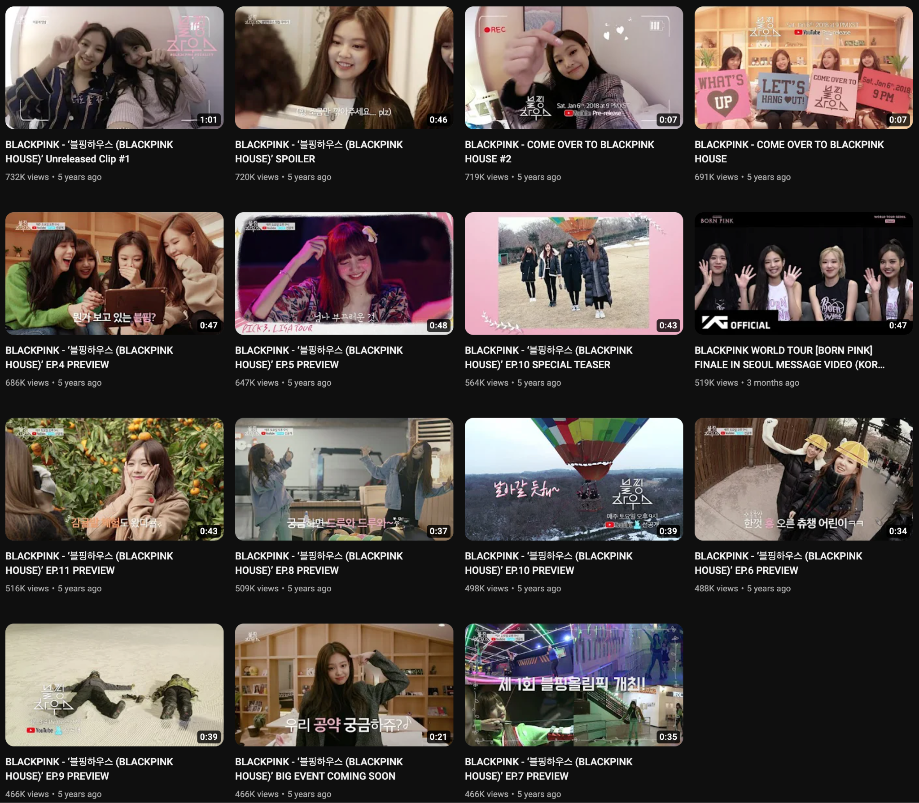

Results - Outliers
Some of the channels had some videos with views that were massive outliers
Views for the most watched videos ranges from 496M to 2.1B while the views for the least watched videos ranges from 466K to 732K

Slide 16
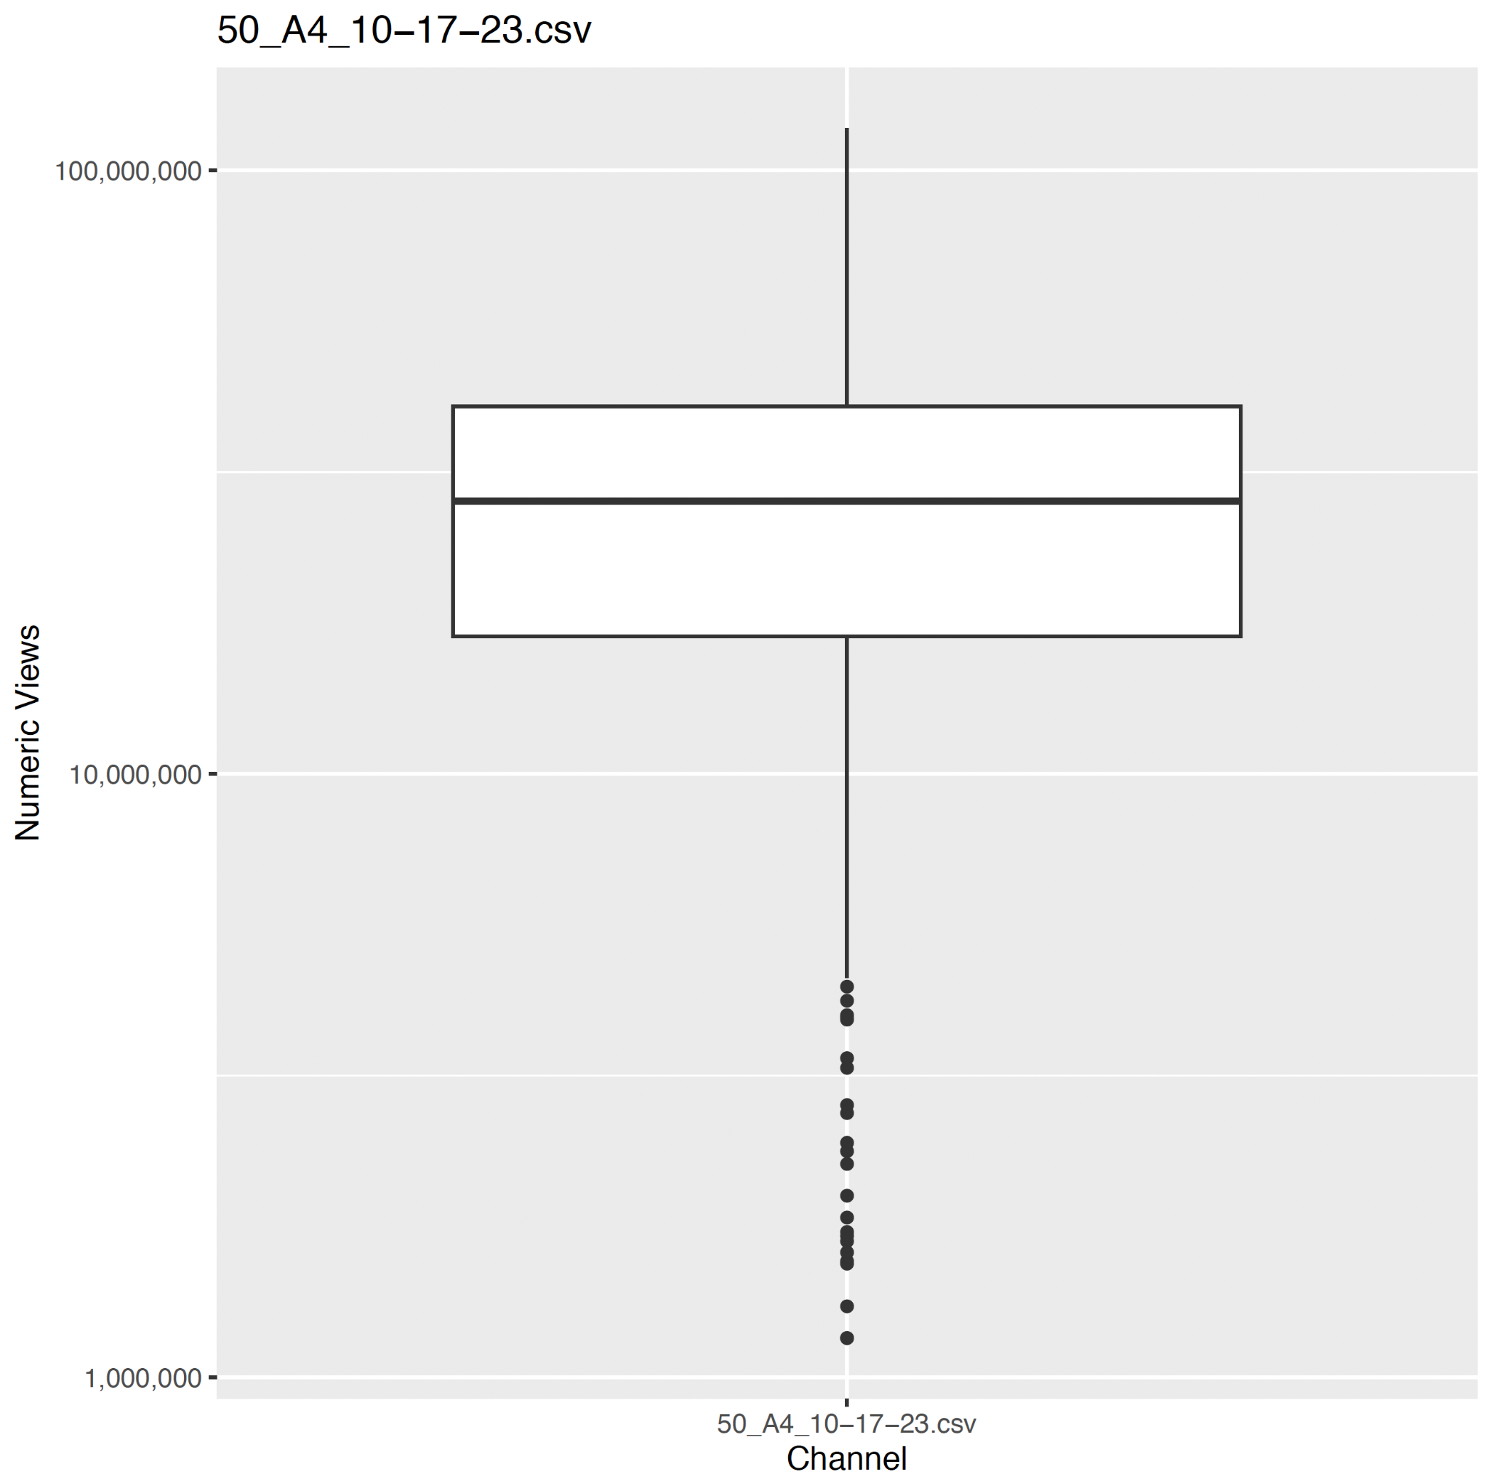
Results- Outliers
Russian content creator
Five number summary
Min: 1,161,696
1st Quartile: 16,896,833
Median: 28,297,385
3rd Quartile: 40,644,632
Max: 117,543,299
Out of ~ 800 videos, most have fewer than 30 mil views

Slide 17
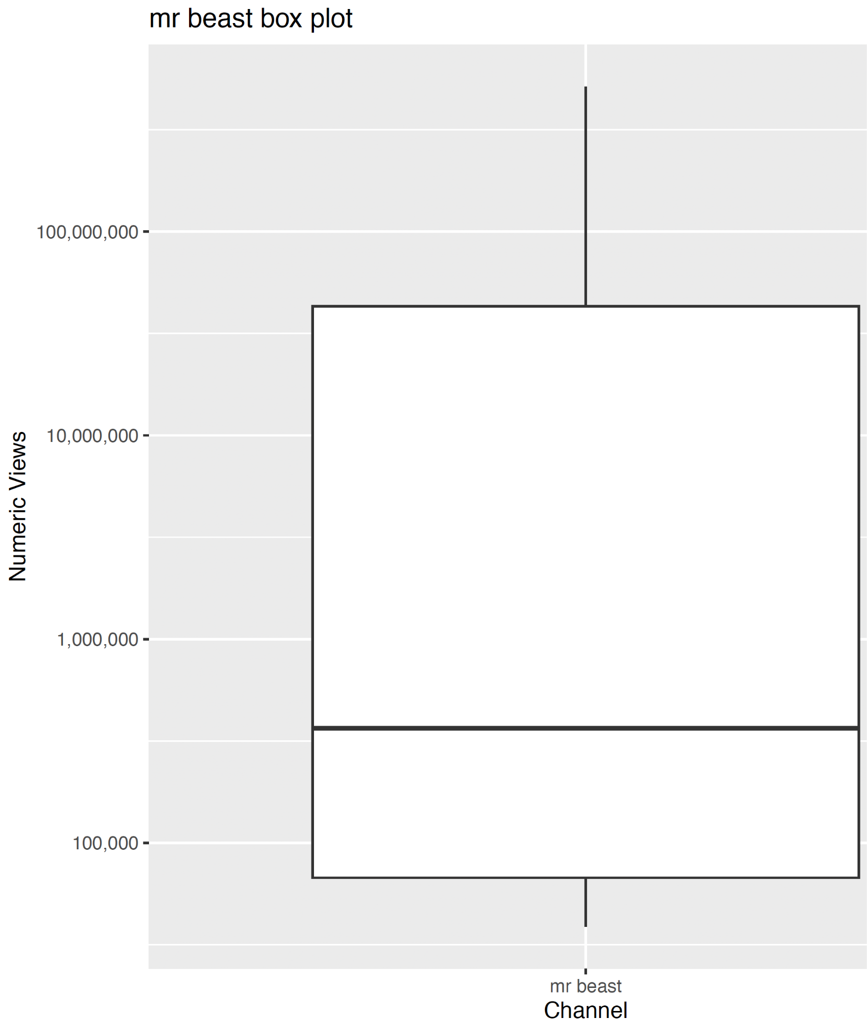
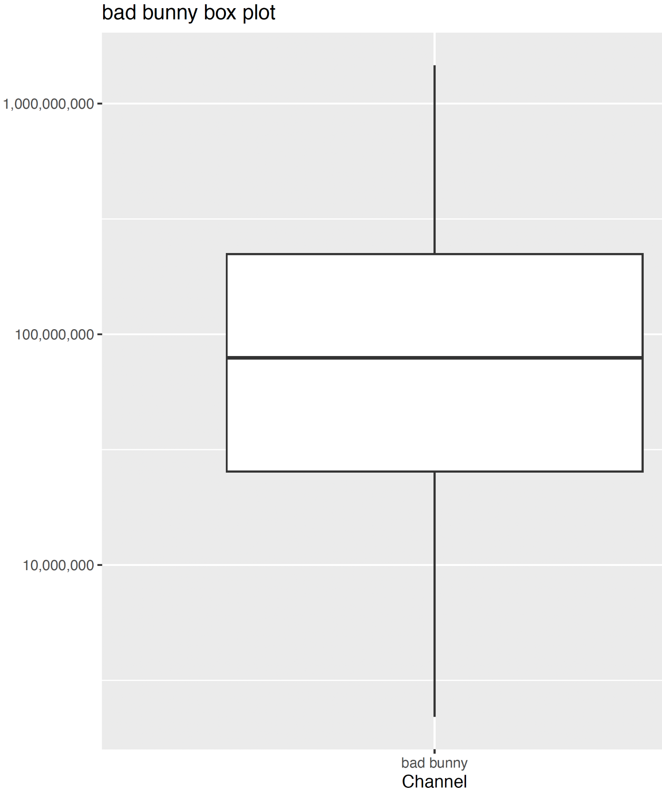
Most vs Least
We had 73 data points so we compared the channels with the most and least subscribers to the channels that sat in the middle
2nd and 54th most subscribers
Misleading because the breaks are different

Slide 18
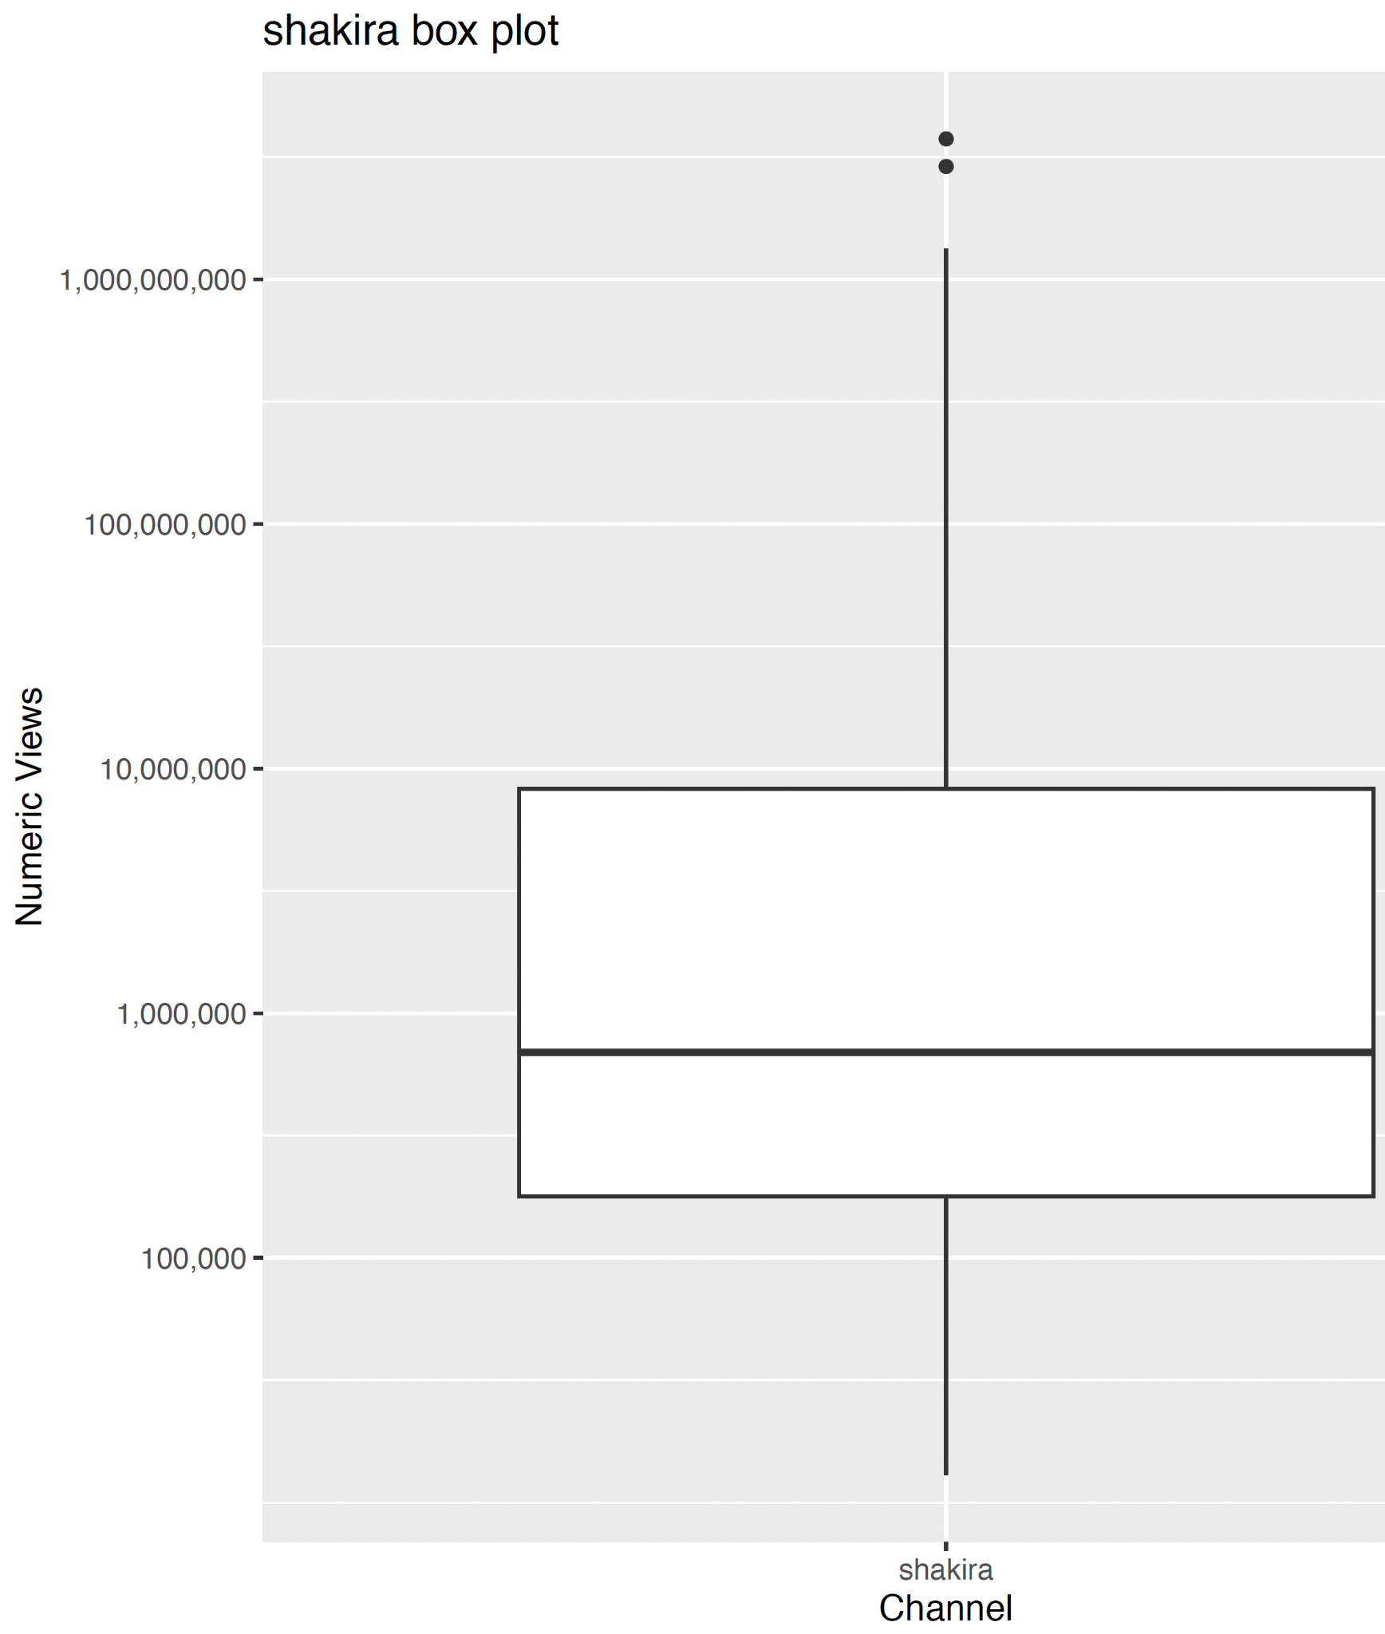
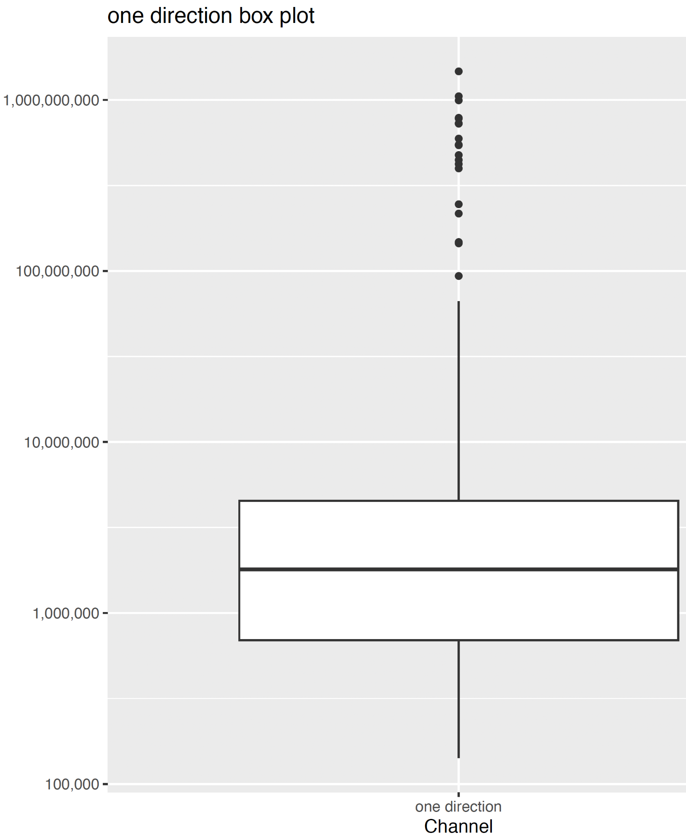
One Direction vs Shakira
60th and 97th most subscribers
One Direction actually has a higher average view count than Shakira

Slide 19
Part 4: Video Age vs Viewcount

Slide 20
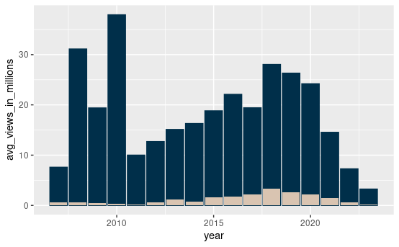
Average vs Median
Big emphasis on virality
Average is dragged up by proportion of big videos to small videos.
Data before 2010 is not the most reliable.
Had to remove 2006.

Slide 21
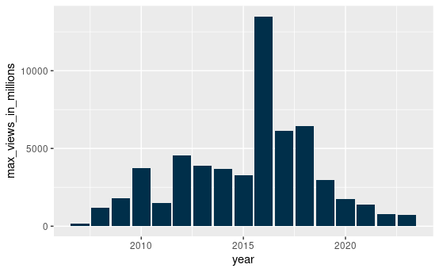

Biggest Viewcounts by Year
The biggest individual videos seem to be from 2012-2018.
The biggest video has about 13 billion views.
That’s about 1.6 times the population of Earth.

Slide 22
Part 5: Conclusions

Slide 23
Subscribers seem to have a minimal impact on viewcount.
Virality is the more important factor.

Slide 24
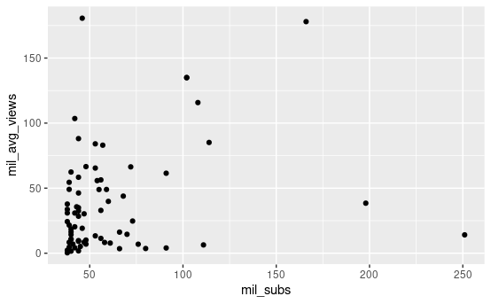
Minimal Correlation
Although there might be a correlation, it seems like having videos go viral is more impactful on viewcount.

Slide 25
Thank you for listening!

